Slide 1
SCHOOL MANAGEMENT STSTEM USING PYTHON
NAME : REONA P
DATE SUBMITTED : 29-12-2025

Slide 2

Aim of the Project
To automate school management processes and minimize manual record maintenance.
To offer an intuitive and user-friendly interface for managing students, teachers, attendance, academic performance, and resources.
To ensure secure and persistent data storage using JSON for efficient retrieval and updates.
To facilitate effective communication among school staff and relevant stakeholders.

Slide 3
Business Problem
Manual handling of school records is labor-intensive and highly susceptible to errors.
Managing attendance, academic performance, and resources without a centralized system leads to inefficiencies.
Communication among teachers, students, and parents is often unstructured and fragmented.
There is a strong need for a scalable and automated solution to ensure smooth and efficient school operations.

Slide 4
Project Description
Overview: A Python-based application that uses JSON for reliable and persistent data storage.
Scope: Manages student enrollment, teacher records, attendance tracking, grading, resource management, and communication.
Technologies Used: Python, JSON, and Object-Oriented Programming (OOP) principles.
Key Features: Modular architecture, robust input validation, effective error handling, and persistent data management.

Slide 5
Functionalities
Student Management: Register and view student details with phone number validation and duplicate record prevention.
Teacher Management: Maintain teacher profiles, including qualifications and assigned subjects.
Attendance Tracking: Record daily attendance and generate detailed attendance reports.
Grade Management: Enter subject-wise grades and produce report cards with GPA calculations.
Resource Management: Add, allocate, and monitor resources while tracking availability and quantities.
Communication System: Send and manage messages to students, parents, and teachers with message history tracking.
Error Handling: Implement strong input validation and exception handling to ensure data accuracy and system reliability.

Slide 6
Input Versatility & Error Handling
Versatile Inputs: Supports roll numbers, teacher IDs, phone numbers, grades, and resource quantities.
Robust Error Handling:
    Validates phone numbers and numeric inputs.
    Prevents duplicate records.
    Gracefully manages missing or invalid data.
Example Scenario: Attempting to mark attendance for a non-existent student triggers an appropriate error message.

Slide 7
Code Implementation
Overview
The School Management System is implemented using Python with an object-oriented approach. It organizes school operations into separate modules for better readability, maintainability, and scalability. Data is stored in structured dictionary-based data structures, simulating persistent storage.
Key Data Structures
A centralized database dictionary stores all system data:
  students, teachers, attendance, grades, resources → stored as dictionaries
  messages → stored as a list of dictionaries
This structure allows quick data retrieval, updates, and validations.

Slide 9
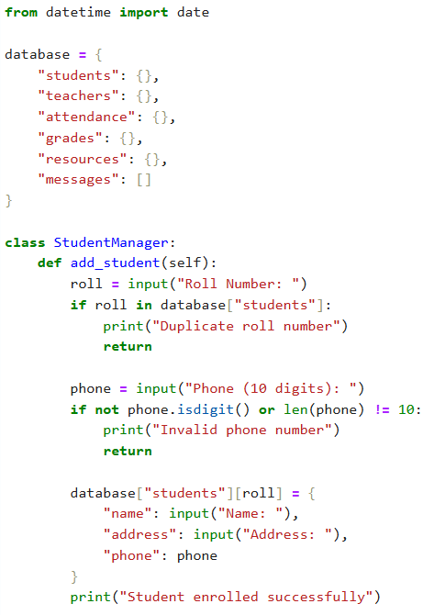
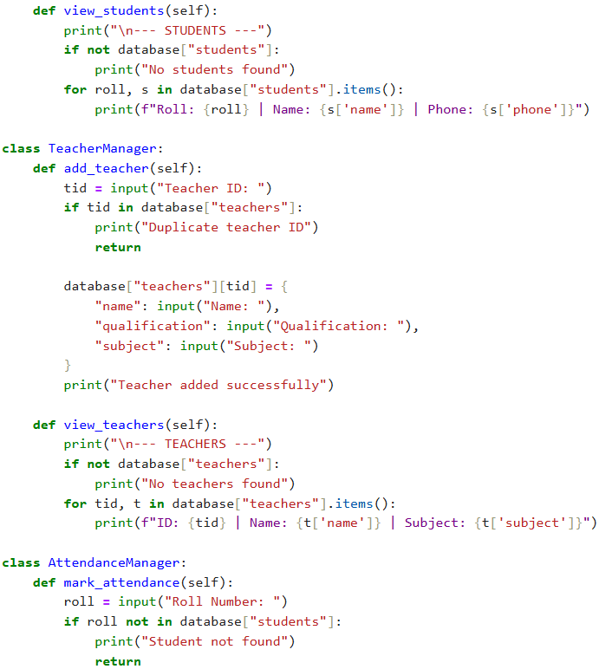
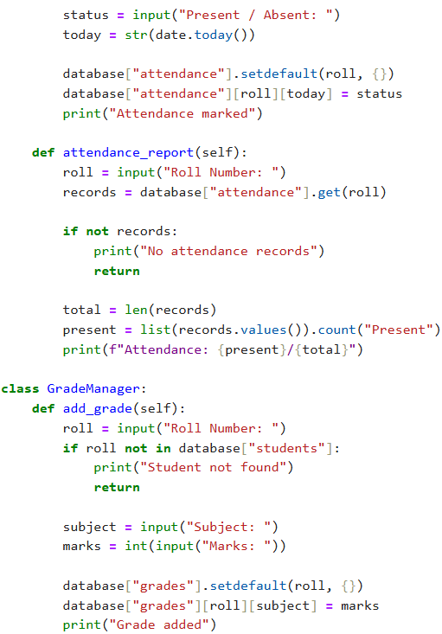
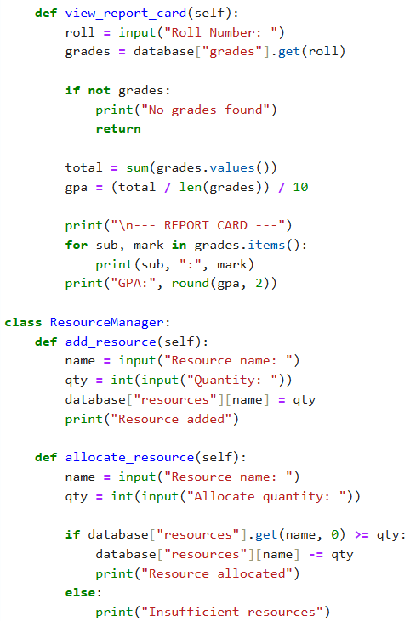
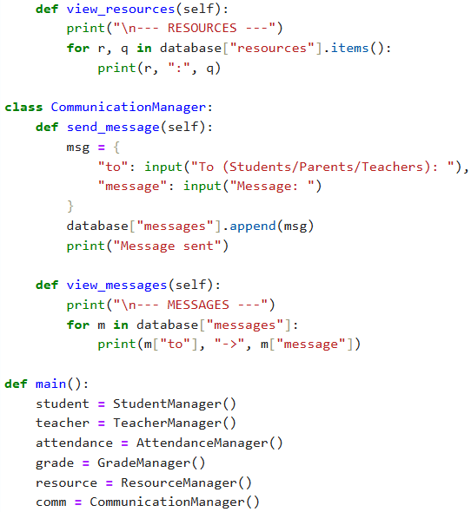
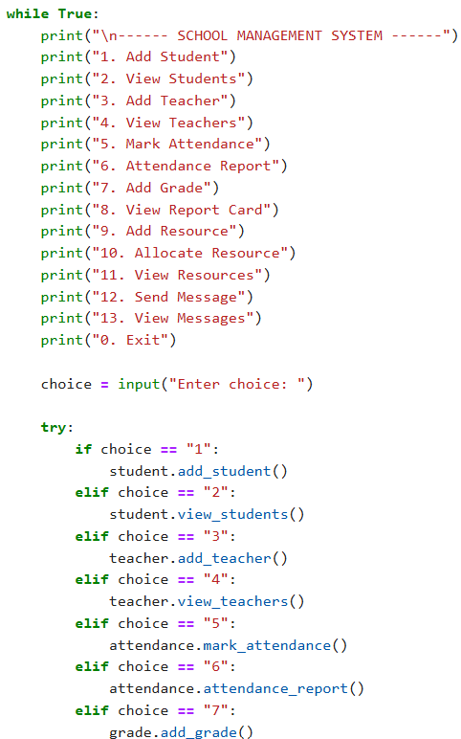
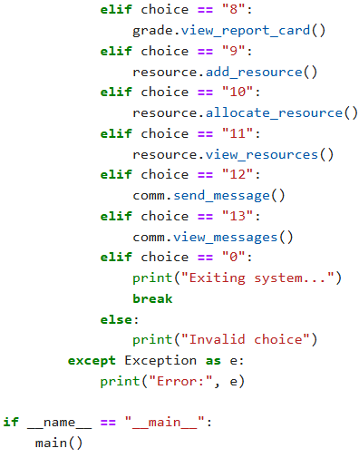

Slide 10
------ SCHOOL MANAGEMENT SYSTEM ------
1. Add Student
2. View Students
3. Add Teacher
4. View Teachers
5. Mark Attendance
6. Attendance Report
7. Add Grade
8. View Report Card
9. Add Resource
10. Allocate Resource
11. View Resources
12. Send Message
13. View Messages
0. Exit
Enter choice: 1
Roll Number: 28
Phone (10 digits): 1235698745
Name: Reo
Address: Ooty
Student enrolled successfully
------ SCHOOL MANAGEMENT SYSTEM ------
1. Add Student
2. View Students
3. Add Teacher
4. View Teachers
5. Mark Attendance
6. Attendance Report
7. Add Grade
8. View Report Card
9. Add Resource
10. Allocate Resource
11. View Resources
12. Send Message
13. View Messages
0. Exit
Enter choice: 2
--- STUDENTS ---
Roll: 28 | Name: Reo | Phone: 1235698745
------ SCHOOL MANAGEMENT SYSTEM ------
1. Add Student
2. View Students
3. Add Teacher
4. View Teachers
5. Mark Attendance
6. Attendance Report
7. Add Grade
8. View Report Card
9. Add Resource
10. Allocate Resource
11. View Resources
12. Send Message
13. View Messages
0. Exit
Enter choice: 3
Teacher ID: 1
Name: Gaya3
Qualification: ME
Subject: Software
Teacher added successfully
------ SCHOOL MANAGEMENT SYSTEM ------
1. Add Student
2. View Students
3. Add Teacher
4. View Teachers
5. Mark Attendance
6. Attendance Report
7. Add Grade
8. View Report Card
9. Add Resource
10. Allocate Resource
11. View Resources
12. Send Message
13. View Messages
0. Exit
Enter choice: 4
--- TEACHERS ---
ID: 1 | Name: Gaya3 | Subject: Software

Slide 11
------ SCHOOL MANAGEMENT SYSTEM ------
1. Add Student
2. View Students
3. Add Teacher
4. View Teachers
5. Mark Attendance
6. Attendance Report
7. Add Grade
8. View Report Card
9. Add Resource
10. Allocate Resource
11. View Resources
12. Send Message
13. View Messages
0. Exit
Enter choice: 5
Roll Number: 28
Present / Absent: Present
Attendance marked
------ SCHOOL MANAGEMENT SYSTEM ------
1. Add Student
2. View Students
3. Add Teacher
4. View Teachers
5. Mark Attendance
6. Attendance Report
7. Add Grade
8. View Report Card
9. Add Resource
10. Allocate Resource
11. View Resources
12. Send Message
13. View Messages
0. Exit
Enter choice: 5
Roll Number: 28
Present / Absent: Present
Attendance marked
------ SCHOOL MANAGEMENT SYSTEM ------
1. Add Student
2. View Students
3. Add Teacher
4. View Teachers
5. Mark Attendance
6. Attendance Report
7. Add Grade
8. View Report Card
9. Add Resource
10. Allocate Resource
11. View Resources
12. Send Message
13. View Messages
0. Exit
Enter choice: 6
Roll Number: 28
Attendance: 1/1
------ SCHOOL MANAGEMENT SYSTEM ------
1. Add Student
2. View Students
3. Add Teacher
4. View Teachers
5. Mark Attendance
6. Attendance Report
7. Add Grade
8. View Report Card
9. Add Resource
10. Allocate Resource
11. View Resources
12. Send Message
13. View Messages
0. Exit
Enter choice: 9
Resource name: Laptop
Quantity: 1
Resource added

Slide 12
------ SCHOOL MANAGEMENT SYSTEM ------
1. Add Student
2. View Students
3. Add Teacher
4. View Teachers
5. Mark Attendance
6. Attendance Report
7. Add Grade
8. View Report Card
9. Add Resource
10. Allocate Resource
11. View Resources
12. Send Message
13. View Messages
0. Exit
Enter choice: 10
Resource name: Laptop
Allocate quantity: 1
Resource allocated
------ SCHOOL MANAGEMENT SYSTEM ------
1. Add Student
2. View Students
3. Add Teacher
4. View Teachers
5. Mark Attendance
6. Attendance Report
7. Add Grade
8. View Report Card
9. Add Resource
10. Allocate Resource
11. View Resources
12. Send Message
13. View Messages
0. Exit
Enter choice: 11
--- RESOURCES ---
Laptop : 0
------ SCHOOL MANAGEMENT SYSTEM ------
1. Add Student
2. View Students
3. Add Teacher
4. View Teachers
5. Mark Attendance
6. Attendance Report
7. Add Grade
8. View Report Card
9. Add Resource
10. Allocate Resource
11. View Resources
12. Send Message
13. View Messages
0. Exit
Enter choice: 12
To (Students/Parents/Teachers): Parents
Message: She Bunk the Class so came to school
Message sent
------ SCHOOL MANAGEMENT SYSTEM ------
1. Add Student
2. View Students
3. Add Teacher
4. View Teachers
5. Mark Attendance
6. Attendance Report
7. Add Grade
8. View Report Card
9. Add Resource
10. Allocate Resource
11. View Resources
12. Send Message
13. View Messages
0. Exit
Enter choice: 13
--- MESSAGES ---
Parents -> She Bunk the Class so came to school
------ SCHOOL MANAGEMENT SYSTEM ------
1. Add Student
2. View Students
3. Add Teacher
4. View Teachers
5. Mark Attendance
6. Attendance Report
7. Add Grade
8. View Report Card
9. Add Resource
10. Allocate Resource
11. View Resources
12. Send Message
13. View Messages
0. Exit

Slide 13


